Slide 1
Automobile Part Manufacturer Company's Data MRA Project – PART A
By: YOGESH NEGI

Slide 2

Contents:
Agenda & Executive Summary of the data
Problem statement
Executive Summary
Data Sictionary
Summary Stats
Assumptions about data
Exploratory Analysis & Insights
Univariate, Bivariate, and multivariate analysis using data visualization
Weekly, Monthly, Quarterly, Yearly Trends in Sales
Sales Across different Categories of different features in the given data
Summarize the inferences from the above analysis
Customer Segmentation using RFM analysis
What is RFM and which tool used
What all parameters used and assumptions made
Output table head
Workflow image to be put when KNIME used
Inferences from RFM Analysis and identified segments
Who are your best customers?
Which customers are on the verge of churning?
Who are your lost customers?
Who are your loyal customers?

Slide 3
Agenda :
Exploratory analysis and insights
02
RFM analysis for customer segmentation
03
Identification of customers based on different parameters
04
Recommendations
05
Agenda & Executive Summary of the data
01

Slide 4
01 Agenda & Executive Summary of the data
Problem statement
About Data (Info, Shape, Summary Stats, your assumptions about data)

Slide 5
Problem Statement:
An automobile parts manufacturing company has collected data on transactions for 3 years. They do not have any in-house data science team, thus they have hired you as their consultant. Your job is to use your data science skills to find the underlying buying patterns of the customers, provide the company with suitable insights about their customers, and recommend customized marketing strategies for different segments of customers.

Slide 6

Executive Summary:
Data: Past 3 Years.
Objective: Uncover inherent customer buying patterns and propose tailored marketing strategies for distinct customer segments.
Dataset: 20 columns and 2747 rows,
Missing values and Duplicate values: None
Outliers: Some columns exhibit a few outlier values.
Exploratory analysis and insights offer a lucid comprehension of the data, shedding light on crucial sales trends and patterns.
RFM analysis was executed to categorize customers into four segments according to their purchasing behavior, followed by tailored marketing strategies proposed for each segment.
The presentation culminates with actionable recommendations to bolster customer relationships and fuel business expansion.

Slide 7
Data Dictionary
ORDERNUMBER : Order Number
CUSTOMERNAME : customer
QUANTITYORDERED : Quantity ordered
PHONE : Phone of the customer
PRICEEACH : Price of Each item
ADDRESSLINE1 : Address of customer
ORDERLINENUMBER : order line
CITY : City of customer
SALES : Sales amount
POSTALCODE : Postal Code of customer
ORDERDATE : Order Date
COUNTRY : Country customer
DAYS_SINCE_LASTORDER : Days_ Since_Lastorder
CONTACTLASTNAME : Contact person customer
STATUS : Status of order like Shipped or not
CONTACTFIRSTNAME : Contact person customer
PRODUCTLINE : Product line – CATEGORY
DEALSIZE : Size of the deal based on Quantity and Item Price
MSRP : Manufacturer's Suggested Retail Price
PRODUCTCODE : Code of Product
Numeric columns: ORDERNUMBER, QUANTITYORDERED, PRICEEACH, ORDERLINENUMBER SALES, DAYS_SINCE_LASTORDER, MSRP.

Slide 8
Assumptions:
Each row corresponds to a distinct customer transaction in the data.
Customer segments can be determined using RFM Analysis, considering purchasing frequency, spending amount, and recency of transactions.
Tailored marketing strategies will differ for each customer segment, necessitating personalized approaches by the company.
The order date and days since last order columns are accurately calculated.
The sales column is derived by multiplying the quantity ordered with the price per unit.
The status column precisely reflects the current order status.
The presentation's recommendations stem from insights gleaned through the analysis of transaction data.

Slide 9
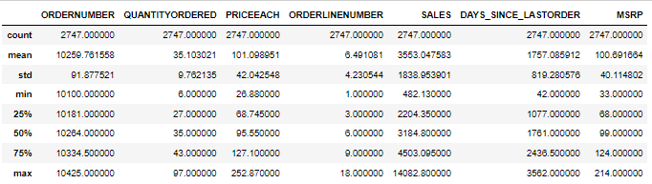
Statistical Summary of Numerical Columns
Inference :
The average number of items ordered per sales order is 35, with a standard deviation of 9.76.
The average price of each item is 101.09, with a standard deviation of 42.04.
The average sales amount per order is 3553.05, with a standard deviation of 1838.95.
The average time since the last order is 1757.09 days, with a standard deviation of 819.28.
The summary statistics do not indicate any red flags or abnormalities that could potentially indicate issues with the data.

Slide 10
02 Exploratory Analysis & Insights Univariate, Bivariate, and multivariate analysis using data visualization
Weekly, Monthly, Quarterly, Yearly Trends in Sales
Sales Across different Categories of different features in the given data
Summarize the inferences from the above analysis
Outliers has not been treated.

Slide 11

Bivariate Analysis

Slide 12
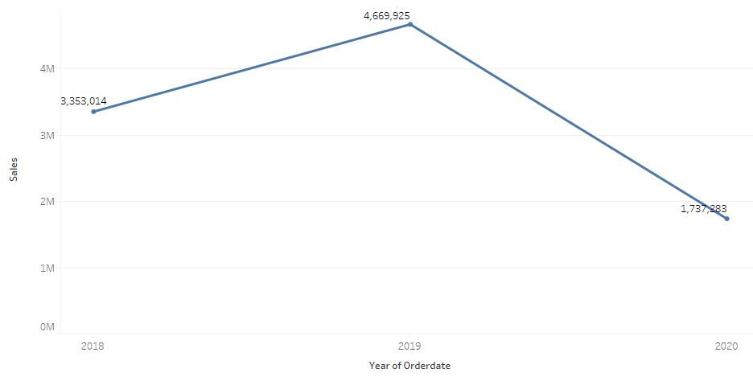
Annual Sales
Yearly sales exhibit a noticeable decline.
Further investigation is necessary to understand the underlying reasons for this decline, as it raises concerns.

Slide 13
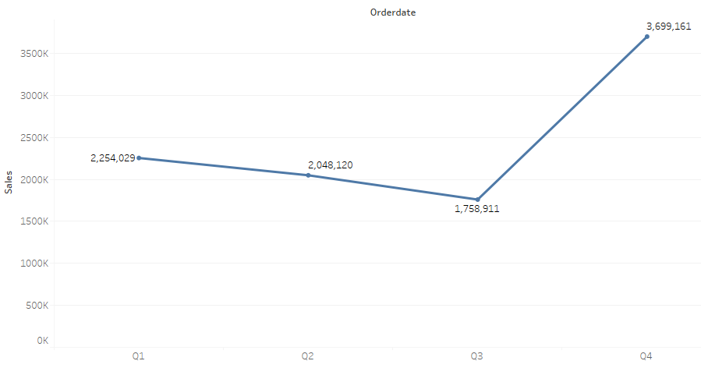
Quarterly Sales
Quarter 4 demonstrates notably higher sales in comparison to the other quarters.

Slide 14
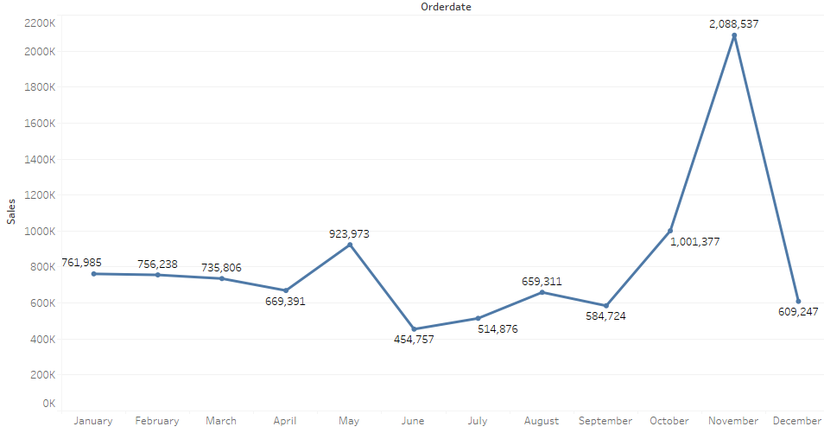
Monthly Sales
The highest sales are observed in the 11th month.
Conversely, the lowest sales are recorded in the 6th month.
Sales remain consistent during the initial four months of the year.

Slide 15
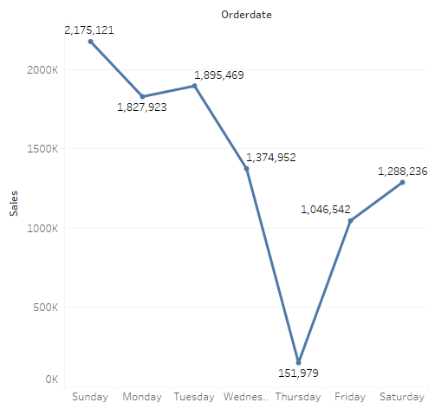
Weekday Sales
Thursday registers the lowest sales, while Sunday boasts the highest sales.
Sales exhibit an ascending trend from Friday through Sunday and experience a descending pattern from Monday to Thursday.

Slide 16
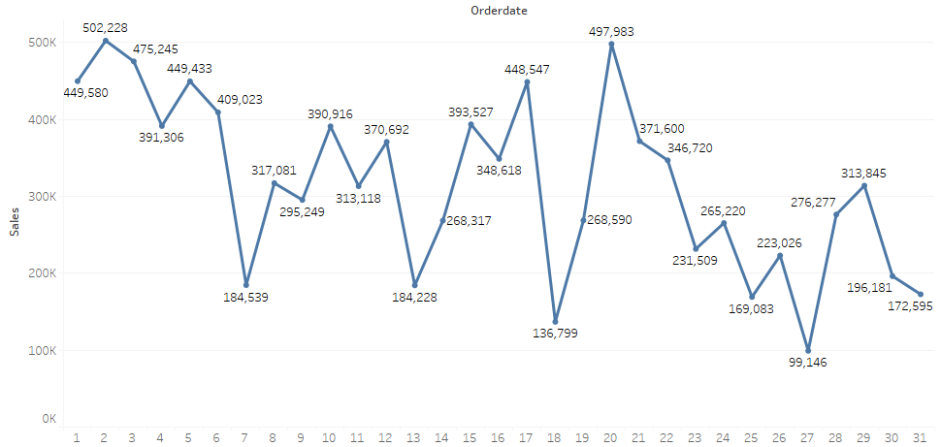
Day Sales
Sales are notably higher in the early days of the month compared to the later days.

Slide 17

Multi-Variate Analysis

Slide 18
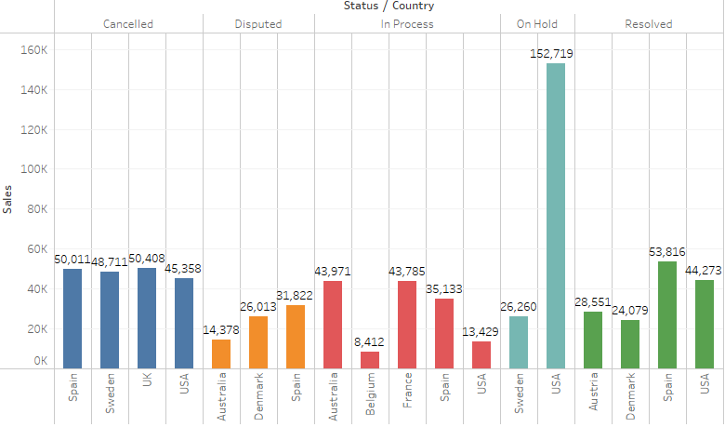
Status, Country & Sales
Predominantly, the orders on hold are linked to the USA, while a portion of on-hold orders is associated with Sweden.
The UK, USA, Spain, and Sweden exhibit approximately similar counts of canceled orders.
Spain has the highest number of disputes, and notably, the majority of these disputes have been successfully resolved.

Slide 19
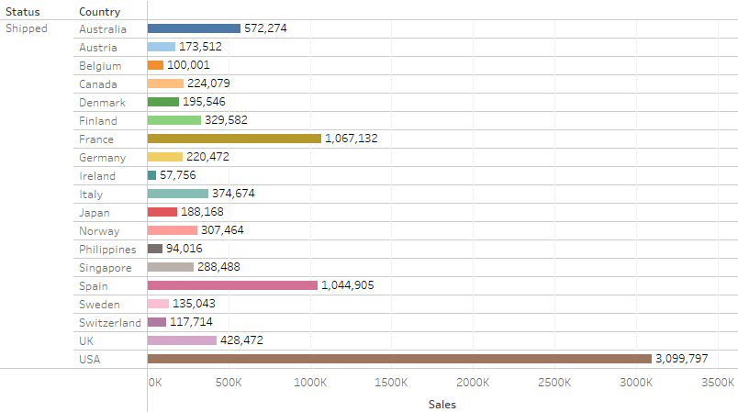
Order Shipped & Sales
USA boasts the highest number of shipped orders.
Spain and France demonstrate approximately equal order counts.
Ireland registers the lowest count of shipped orders.

Slide 20
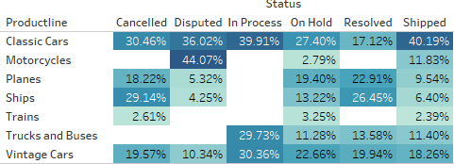
Pivot Table
A significant percentage of individuals engage in transactions related to classic car parts, reflecting a notable preference.
The 'Parts of Motorcycles' category stands out as the most disputed product category.
Train parts witness the least engagement among individuals.

Slide 21
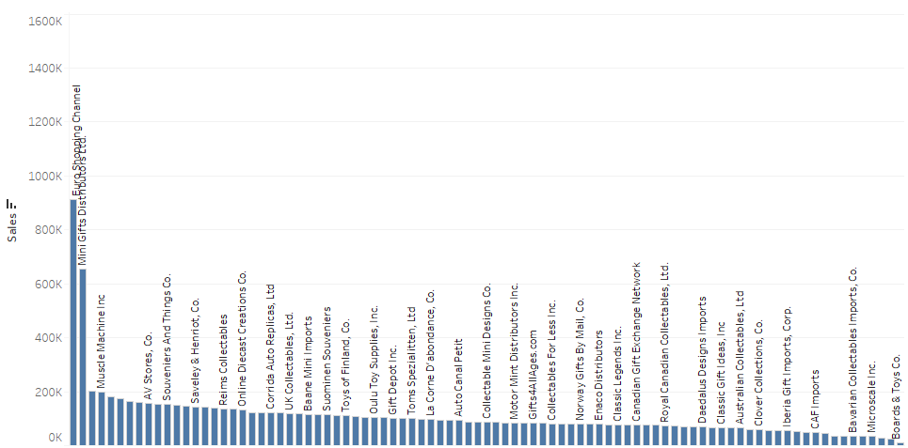
Sales & Customer names

Slide 22
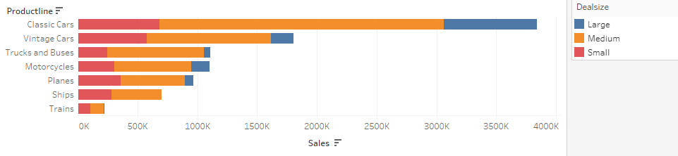
Sales & Deal Size
Classic cars lead in terms of the highest sales.
Trains record the lowest sales.
Medium deal size prevails as the most common.
Large deal size emerges as the least common.
Sales of 'Truck and Buses' and 'Motorcycle' products are approximately equal.

Slide 23
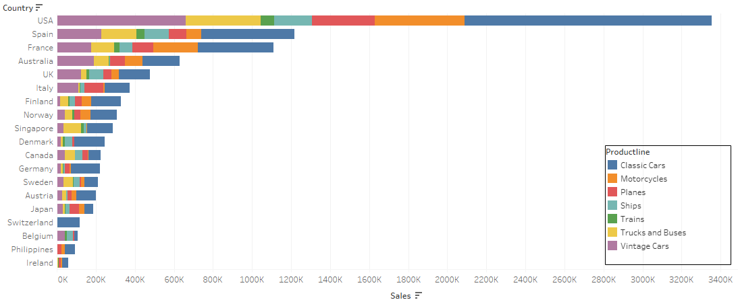
Country, Product line, Sales
USA leads with the highest sales.
Ireland reports the lowest sales.
Switzerland exclusively engages in transactions related to classic car parts.

Slide 24
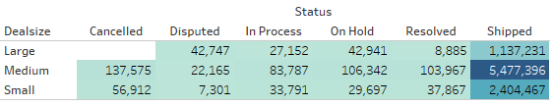
Status, Sales and Deal Size
The absence of canceled orders for the 'Large Deal' type is a positive indicator.
The majority of shipped parts are associated with the 'Medium Deal' size type.

Slide 25
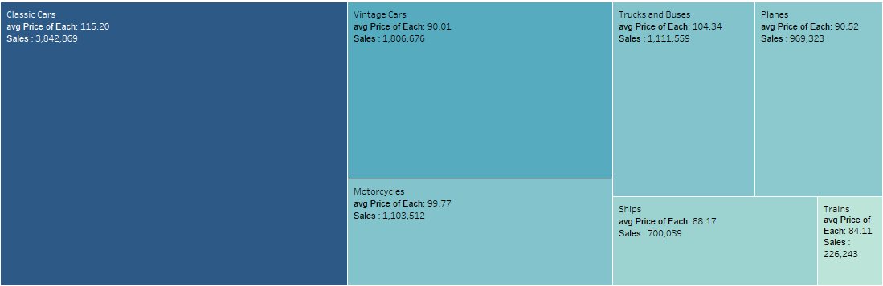
PRODUCT LINE AND SALES

Slide 26

Univariate Analysis

Slide 27
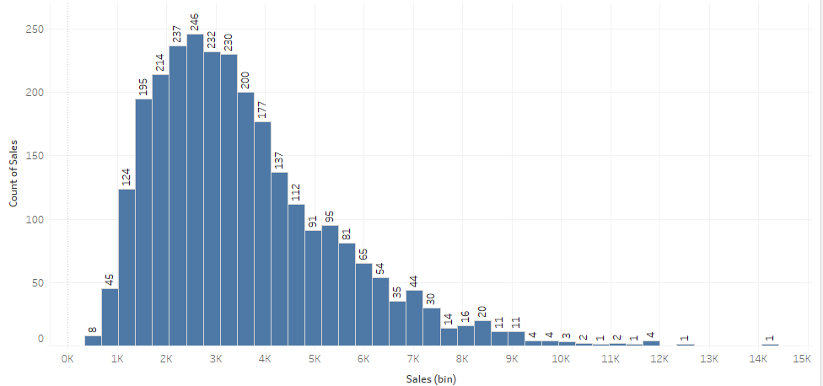
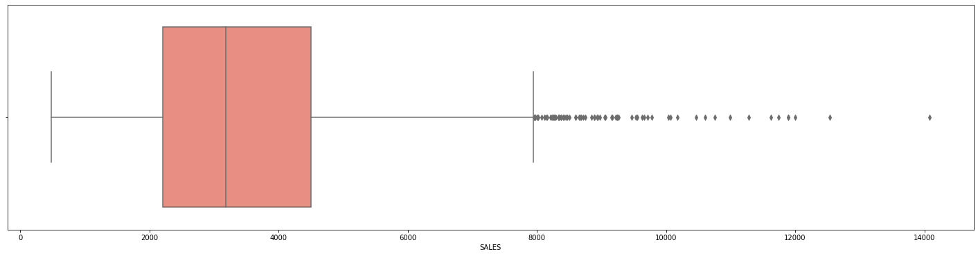
Sales
The sales data displays a left-skewed distribution.
Numerous outliers are present.
The majority of the data falls within the range of 1.5k to 3.5k.

Slide 28
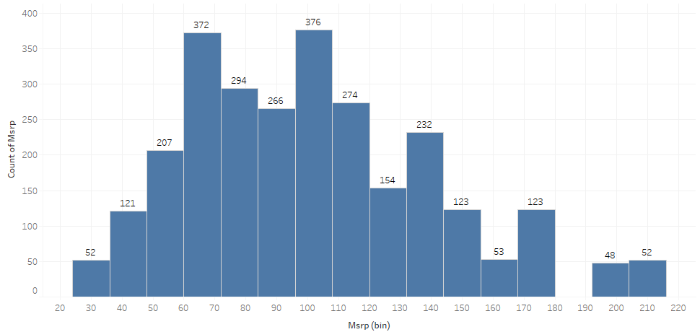
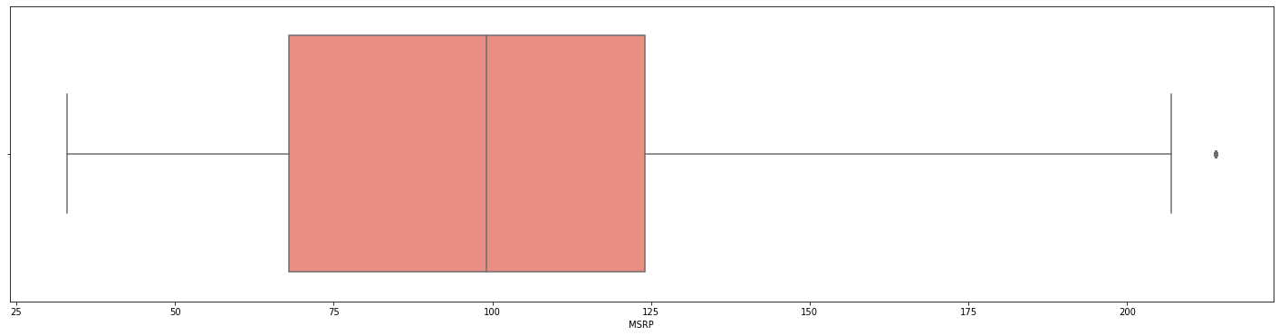
MRSP
Outliers are detected within the MRSP Data.
This data exhibits a left-skewed distribution.

Slide 29
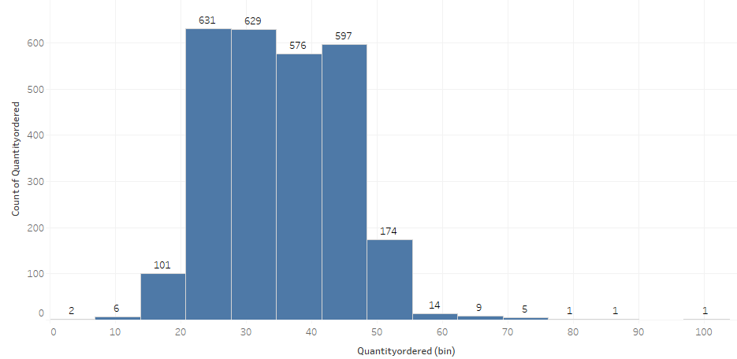
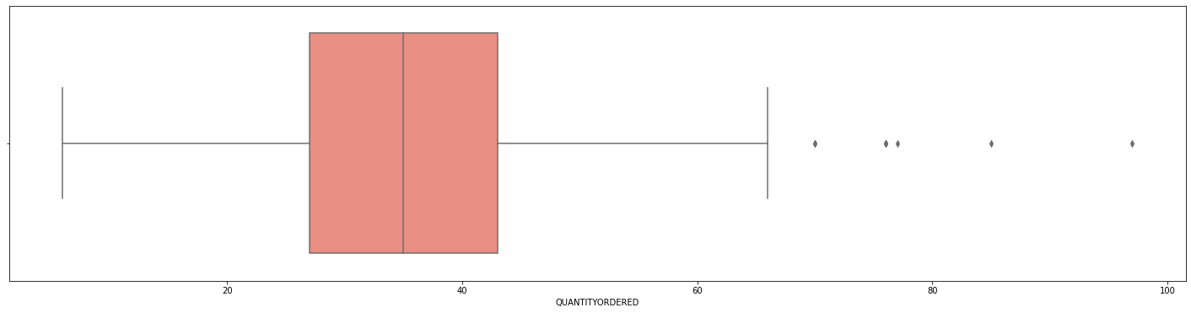
QUANTITY ORDERED
Outliers are observed within the Quantity Ordered data.

Slide 30
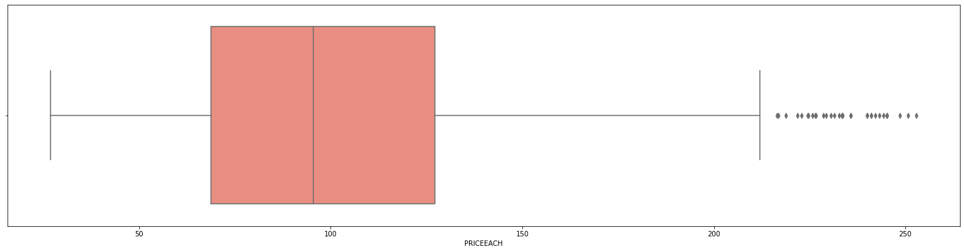
PRICE OF EACH
The 'Price of Each' data contains notable monetary outliers.

Slide 31

Dashboard : Sales

Slide 32
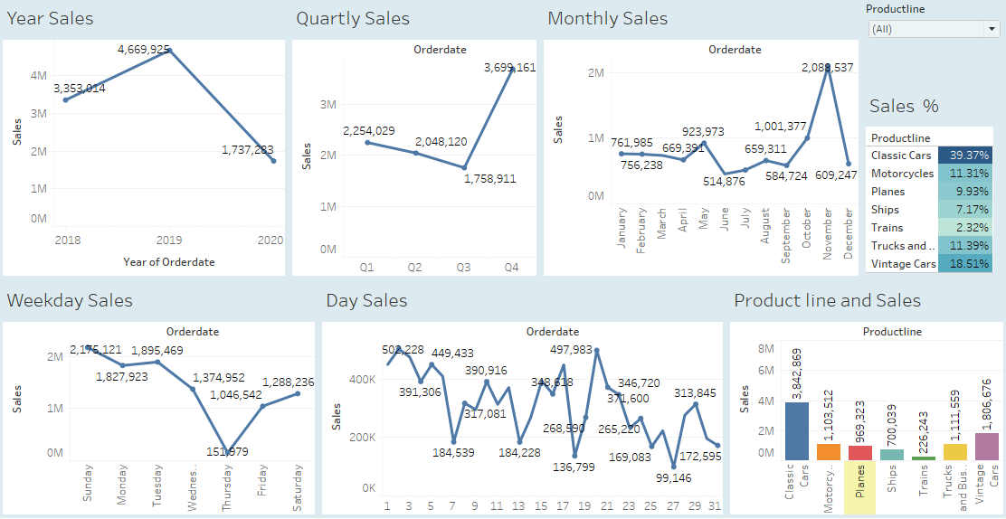

Slide 33
INFERENCES
Yearly sales have experienced a decline, raising concerns.
Quarter 4 stands out with higher sales compared to the other quarters.
Sales maintain consistency during the initial four months of the year.
Thursday records the lowest sales, while Sunday garners the highest sales.
Sales exhibit an upward trend from Friday through Sunday and show a decline from Monday to Thursday.
Sales are notably higher in the early days of the month compared to the later days.
The majority of on-hold orders are attributed to the USA, with a portion originating from Sweden.
Spain, USA, UK, and Sweden exhibit similar counts of canceled orders.
Spain records the highest number of disputes, with a significant majority successfully resolved.
Classic car parts account for the highest percentage of sales.

Slide 34
Recommendation
Further investigation is required to uncover the underlying causes of the decline in yearly sales.
To leverage the strong sales in quarter 4, businesses should prioritize increasing their inventory during this period.
Businesses should investigate the factors contributing to the low sales in the 6th month and take proactive steps to address them.
To enhance sales, businesses can channel their marketing efforts towards Thursdays.
Implementing strategies like weekend sales can effectively boost sales from Friday to Sunday.
Businesses can enhance sales by considering discounts or promotions at the beginning of each month.
Efforts should be directed towards resolving orders on hold to prevent potential revenue loss.
Close monitoring of canceled orders is advised to identify trends and implement necessary actions.
Implement streamlined dispute resolution processes to ensure swift and satisfactory resolutions, upholding customer satisfaction.
Considering the significant sales percentage, businesses should explore expanding their classic car parts inventory.

Slide 35
03 Customer Segmentation using RFM analysis
What is RFM and which tool used
What all parameters used and assumptions made
Output table head
Workflow image to be put when KNIME used

Slide 36
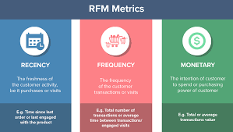
What is RFM ?
RFM analysis is a marketing tool that identifies a firm's top clients by analyzing their spending habits in terms of recency, frequency, and monetary value.
RFM analysis scores clients based on three criteria: recency of purchase, frequency of buying, and the monetary value of their purchases.

Slide 37

Tool used : KNIME
KNIME, the Konstanz Information Miner, is a free and open-source data analytics, reporting and integration platform.

Slide 38
What all parameters used and assumptions made:
Following instructions, the 'Days since last order' column is disregarded, and a new 'Recency' column is created as '[Max(order date) - order date]'.
We have established '01-06-2020' as the reference date and generated the recency column accordingly.
The calculated formula for:
Recency :- [min(Recency) customer wise].
Frequency:- [count(customer name) customer wise]. We can also take order quantity
Monetary:- [sum(unit price + qty ordered) customer wise]. We can also take sales
Based on above we have made 3 bins : high , medium , low

Slide 39
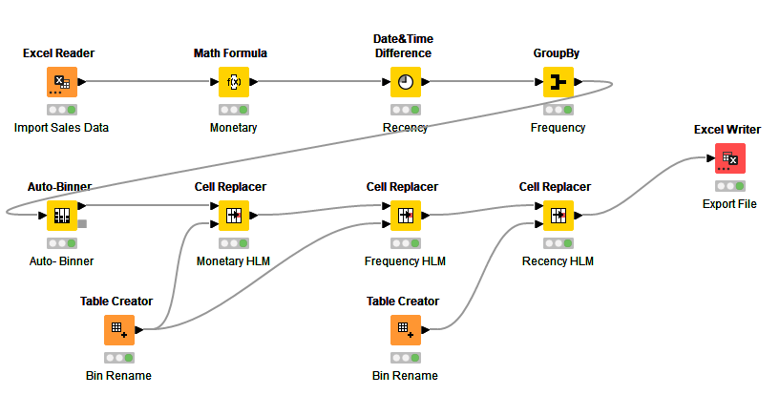
KNIME Workflow

Slide 40
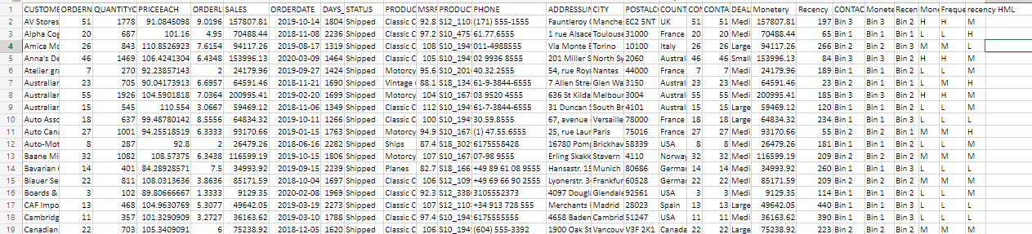
Few rows of output

Slide 41
Inferences from RFM Analysis and identified segments
Who are your best customers? Which customers are on the verge of churning? Who are your lost customers?
Who are your loyal customers?

Slide 42
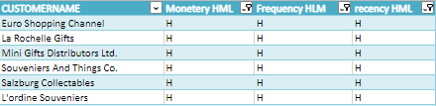
Top 5 best customers
Using the RFM score, we have categorized the top customers into groups.
We have prioritized recency and organized the customers accordingly.

Slide 43
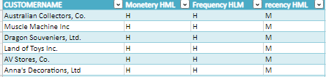
Top loyal customers
These customers are identified as loyal based on the RFM analysis.
Our focus has been on the monetary value aspect.
By concentrating on these customers, we have the potential to transform them into our best customers.

Slide 44
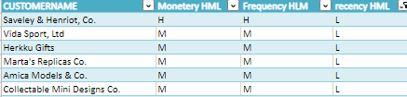
Customers on the brink of churning.
Based on the RFM score, these customers are flagged as top customers who are in danger of churning.
It's important to prioritize these customers and take action before losing them.
We should implement an action plan to transform them into loyal, regular customers.

Slide 45
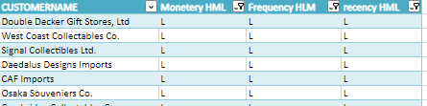
Top Lost Customers
According to the RFM score, these are the customers we have lost.
Their recency is quite low, and they haven't made frequent purchases either.
We should conduct a study or survey to understand the reasons behind their attrition and take necessary steps to prevent further customer losses.

Slide 46
05 Recommendations

Slide 47

Recommendations
RFM analysis categorizes customers into four groups: best, loyal, verge of churn, and lost customers. Customizing strategies for each group is crucial to maximize retention and improve customer experience.
For our best customers, it's advisable to offer personalized recognition, exclusive incentives, and special offers, ensuring their continued preference for our company. This approach will help cultivate loyalty and reinforce long-term relationships.
To retain our loyal customers, it's important to provide regular discounts and offers to maintain their engagement and interest in our products or services. This engagement can lead them to become our best customers, elevating their satisfaction and strengthening their connection with our brand.
For customers on the verge of churn, it's crucial to create a robust action plan aimed at retaining them. This involves surveys, tailored incentives, and personalized communication to identify and resolve their concerns, ultimately boosting their loyalty to our brand.
For lost customers, analyzing their behaviors and preferences is essential to pinpoint the reasons behind their departure. By understanding the main drivers of customer churn, we can create focused strategies to avert such situations in the future and enhance our overall retention rate.

Slide 48

Thank you

